Slide 1
Grammar Transforms
Restricting the grammar form for efficient parsing

Slide 2
Chomsky Normal Form
All rules are of the form X → Y Z or X → w
X, Y, Z ∈ N and w ∈ T
A transformation to this form doesn’t change the weak generative capacity of a CFG
That is, it recognizes the same language
But maybe with different trees
Empties and unaries are removed recursively
n-ary rules are divided by introducing new nonterminals (n > 2)

Slide 3
A phrase structure grammar
S → NP VP
VP → V NP
VP → V NP PP
NP → NP NP
NP → NP PP
NP → N
NP → e
PP → P NP
N → people
N → fish
N → tanks
N → rods
V → people
V → fish
V → tanks
P → with
Notes:
Start discussing epsilon removal

Slide 4
Chomsky Normal Form steps
S → NP VP
S → VP
VP → V NP
VP → V
VP → V NP PP
VP → V PP
NP → NP NP
NP → NP
NP → NP PP
NP → PP
NP → N
PP → P NP
PP → P
N → people
N → fish
N → tanks
N → rods
V → people
V → fish
V → tanks
P → with
Notes:
Start discussing unary removal downwards: remove S → VP

Slide 5
Chomsky Normal Form steps
S → NP VP
VP → V NP
S → V NP
VP → V
S → V
VP → V NP PP
S → V NP PP
VP → V PP
S → V PP
NP → NP NP
NP → NP
NP → NP PP
NP → PP
NP → N
PP → P NP
PP → P
N → people
N → fish
N → tanks
N → rods
V → people
V → fish
V → tanks
P → with
Notes:
Remove more unaries, next S → V

Slide 6
Chomsky Normal Form steps
S → NP VP
VP → V NP
S → V NP
VP → V
VP → V NP PP
S → V NP PP
VP → V PP
S → V PP
NP → NP NP
NP → NP
NP → NP PP
NP → PP
NP → N
PP → P NP
PP → P
N → people
N → fish
N → tanks
N → rods
V → people
S → people
V → fish
S → fish
V → tanks
S → tanks
P → with
Notes:
After remove S → V get this, and then do VP → V

Slide 7
Chomsky Normal Form steps
S → NP VP
VP → V NP
S → V NP
VP → V NP PP
S → V NP PP
VP → V PP
S → V PP
NP → NP NP
NP → NP
NP → NP PP
NP → PP
NP → N
PP → P NP
PP → P
N → people
N → fish
N → tanks
N → rods
V → people
S → people
VP → people
V → fish
S → fish
VP → fish
V → tanks
S → tanks
VP → tanks
P → with
Notes:
Remove more unaries, next NP → NP (easy, cross-it-off) and then NP → N.
Since this is the only place N appears on the RHS of a grammar rule, we can delete it from our set of nonterminals altogether.
Then NP → PP and PP → P

Slide 8
Chomsky Normal Form steps
S → NP VP
VP → V NP
S → V NP
VP → V NP PP
S → V NP PP
VP → V PP
S → V PP
NP → NP NP
NP → NP PP
NP → P NP
PP → P NP
NP → people
NP → fish
NP → tanks
NP → rods
V → people
S → people
VP → people
V → fish
S → fish
VP → fish
V → tanks
S → tanks
VP → tanks
P → with
PP → with
Notes:
And then binarize

Slide 9
Chomsky Normal Form steps
S → NP VP
VP → V NP
S → V NP
VP → V @VP_V
@VP_V → NP PP
S → V @S_V
@S_V → NP PP
VP → V PP
S → V PP
NP → NP NP
NP → NP PP
NP → P NP
PP → P NP
NP → people
NP → fish
NP → tanks
NP → rods
V → people
S → people
VP → people
V → fish
S → fish
VP → fish
V → tanks
S → tanks
VP → tanks
P → with
PP → with
Notes:
Chomsky Normal form!

Slide 10
A phrase structure grammar
S → NP VP
VP → V NP
VP → V NP PP
NP → NP NP
NP → NP PP
NP → N
NP → e
PP → P NP
N → people
N → fish
N → tanks
N → rods
V → people
V → fish
V → tanks
P → with
Notes:
Now, if a linguist hands you this

Slide 11
Chomsky Normal Form steps
S → NP VP
VP → V NP
S → V NP
VP → V @VP_V
@VP_V → NP PP
S → V @S_V
@S_V → NP PP
VP → V PP
S → V PP
NP → NP NP
NP → NP PP
NP → P NP
PP → P NP
NP → people
NP → fish
NP → tanks
NP → rods
V → people
S → people
VP → people
V → fish
S → fish
VP → fish
V → tanks
S → tanks
VP → tanks
P → with
PP → with
Notes:
and you hand them back this, then they tend not to be very happy.

Slide 12
Chomsky Normal Form
You should think of this as a transformation for efficient parsing
With some extra book-keeping in symbol names, you can even reconstruct the same trees with a detransform
In practice full Chomsky Normal Form is a pain
Reconstructing n-aries is easy
Reconstructing unaries/empties is trickier
Binarization is crucial for cubic time CFG parsing
The rest isn’t necessary; it just makes the algorithms cleaner and a bit quicker

Slide 13
An example: before binarization…
ROOT
S
NP
VP
V
NP
PP
N
P
NP
N
N
people
fish
tanks
with
rods

Slide 14
After binarization…
ROOT
S
NP
VP
@VP_V
N
V
NP
PP
N
P
NP
N
people
fish
tanks
with
rods

Slide 15
Treebank: empties and unaries
ROOT
ROOT
ROOT
ROOT
ROOT
S-HLN
S
S
S
NP-SUBJ
VP
NP
VP
VP
-NONE-
VB
-NONE-
VB
VB
VB
e
Atone
e
Atone
Atone
Atone
Atone
PTB Tree
NoFuncTags
NoEmpties
High
Low
NoUnaries

Slide 16
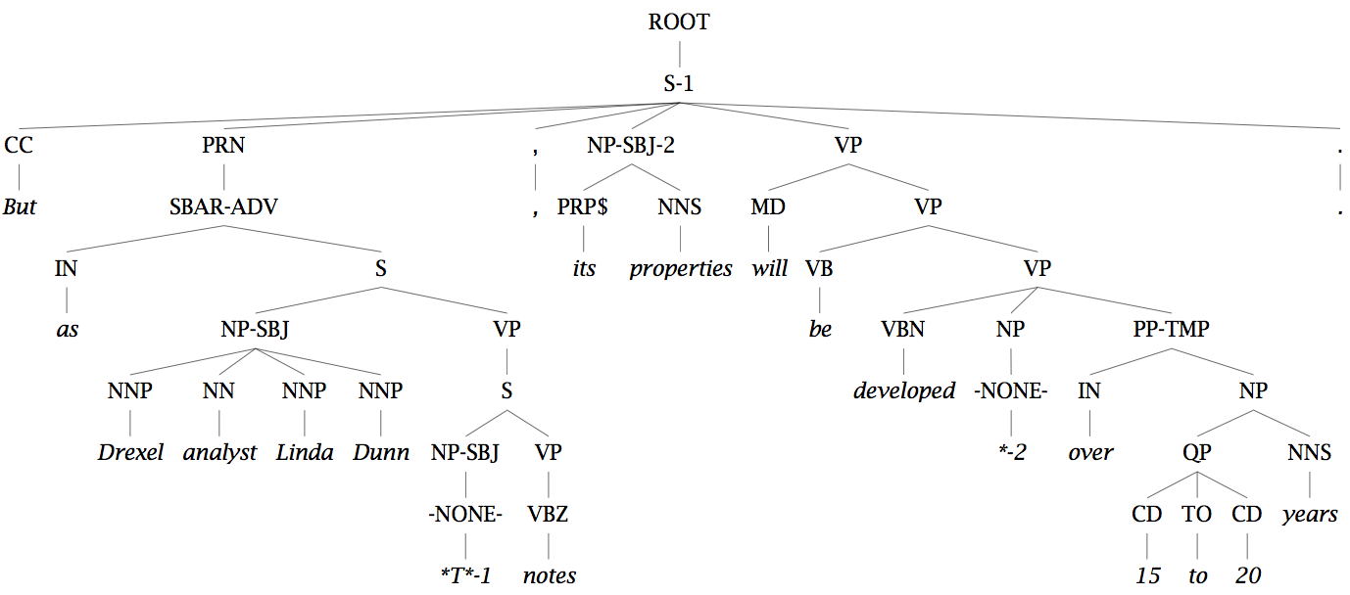
Unary rules: alchemy in the land of treebanks

Slide 17
Same-Span Reachability
TOP
NoEmpties
NX
SQ
X
RRC
LST
ADJP ADVP
FRAG INTJ NP
PP PRN QP S
SBAR UCP VP
WHNP
CONJP
NAC
SINV
PRT
SBARQ
WHADJP
WHPP
WHADVP
Notes:
SCC: Strongly connected component.

Slide 18
Grammar Transforms
Restricting the grammar form for efficient parsing

